Slide 1


<Marco Leti>
<05 October 2021>

Slide 2

Outline
Executive Summary
Introduction
Methodology
Results
Conclusion
Appendix

Slide 3
Executive Summary
Summary of methodologies
Summary of all results

Slide 4
Introduction
SpaceX advertises Falcon 9 rocket launches on its website, with a cost of 62 million dollars; other providers cost upward of 165 million dollars each, much of the savings is because SpaceX can reuse the first stage.
We, at SpaceY, will predict if the Falcon 9 first stage will land successfully through the use of Data Science. If we can determine if the first stage will land, we can determine the cost of a launch

Slide 5


Slide 6
Methodology
Executive Summary
Data collection methodology:
Request to the SpaceX API and web scraping Wikipedia page
Perform data wrangling
Calculate the number of launches on each site
Calculate the number and occurrence of each orbit
Calculate the number and occurrence of mission outcome per orbit type
Create a landing outcome label from Outcome column
Perform exploratory data analysis (EDA) using visualization and SQL
Perform interactive visual analytics using Folium and Plotly Dash
Perform predictive analysis using classification models
Usage of Logistic regression, SVM, Tree and KNN models

Slide 7
Data Collection
A request to the SpaceX API was performed. The SpaceX REST API endpoints, or URL, starts with api.spacexdata.com/v4/. We have the different end points, for example: /capsules and /cores We will be working with the endpoint api.spacexdata.com/v4/launches/past.
To convert this JSON to a dataframe, we will use the json_normalize function.
Another source for obtaining Falcon 9 Launch data is web scraping related Wiki pages using the Python BeautifulSoup package
Then we parse the data from those tables and convert them into a Pandas data frame for further visualization and analysis.

Slide 8
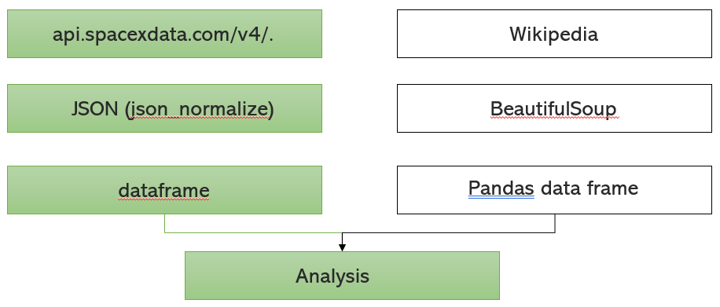
Data Collection – SpaceX API
Source: https://github.com/MarcoLeti/IBMProfessionalDS/blob/main/1.1_Data_Collection.ipynb

Slide 9
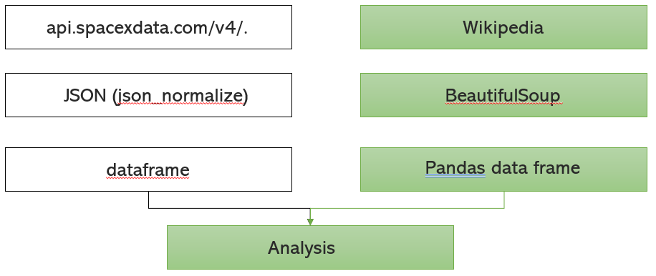
Data Collection - Scraping
Source: https://github.com/MarcoLeti/IBMProfessionalDS/blob/main/1.1_Data_Collection.ipynb

Slide 10
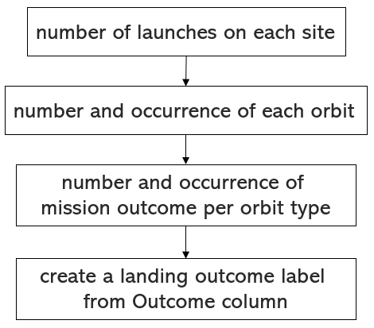
Data Wrangling
Source: https://github.com/MarcoLeti/IBMProfessionalDS/blob/main/1.2_DataWrangling.ipynb

Slide 11
EDA with Data Visualization
Scatterplot to Visualize the relationship between Flight Number and Launch Site
Scatterplot Visualize the relationship between Payload and Launch Site
Bar Chart to Visualize the relationship between success rate of each orbit type
Scatterplot to Visualize the relationship between FlightNumber and Orbit type
Scatterplot to Visualize the relationship between Payload and Orbit type
Line chart to Visualize the launch success yearly trend
Source: https://github.com/MarcoLeti/IBMProfessionalDS/blob/main/2.2_EDAWithPython.ipynb

Slide 12
EDA with SQL
Using bullet point format, summarize the SQL queries you performed
Add the GitHub URL of your completed EDA with SQL notebook, as an external reference and peer-review purpose

Slide 13
Build an Interactive Map with Folium
Markers:
All launch sites on a map were marked. We added to answer to these questions:
Are all launch sites in proximity to the Equator line?
Are all launch sites in very close proximity to the coast?
Success/failed launches for each site on the map. We added to answer to these questions:
to easily identify which launch sites have relatively high success rate
Source: https://github.com/MarcoLeti/IBMProfessionalDS/blob/main/3.1_VisualAnalytics.ipynb

Slide 14
Build a Dashboard with Plotly Dash
Pie Chart with success rates of specific sites or total will allow to visualize if there is a correlation between place and success or failure
Scatter plot showing the relation between payload mass and class specific for every booster version, will allow to identify if there is any correlation between success and payload for a specific site or for the general case
Source: https://github.com/MarcoLeti/IBMProfessionalDS/blob/main/spacex_dash_app.py

Slide 15
GridSearchCV
Predictive Analysis (Classification)
We built 4 different classification models:
Logistic Regression
SVM
Decision Tree
KNN
Hyperparameter tuning done with GridSearchCV function with cv of 10
Confusion matrix and accuracy scores calculated to find the best model
Source: https://github.com/MarcoLeti/IBMProfessionalDS/blob/main/4.1_PredictiveAnalytics.ipynb

Slide 16
Results
Exploratory data analysis results
Interactive analytics demo in screenshots
Predictive analysis results

Slide 17


Slide 18
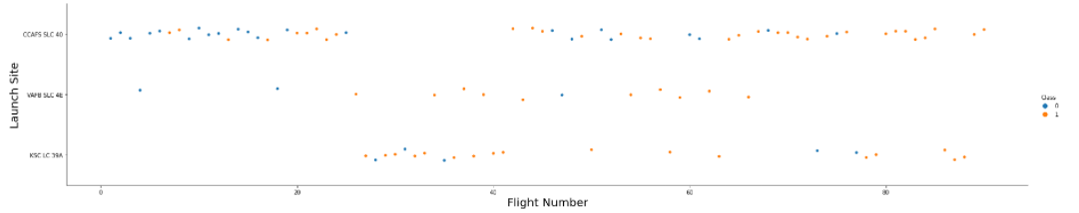
Flight Number vs. Launch Site
Flight Number vs. Launch Site
Positive launch outcomes seem to be related with high numbe

Slide 19
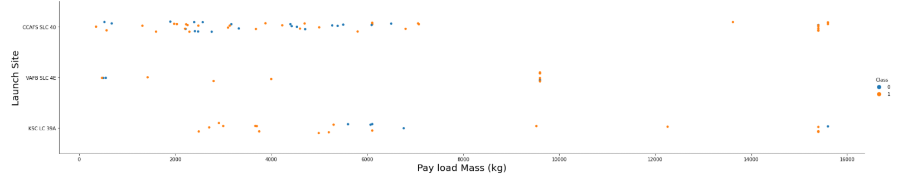
Payload vs. Launch Site
Payload vs. Launch Site
Some measures of payload mass seem to be launched only on certain sites.

Slide 20
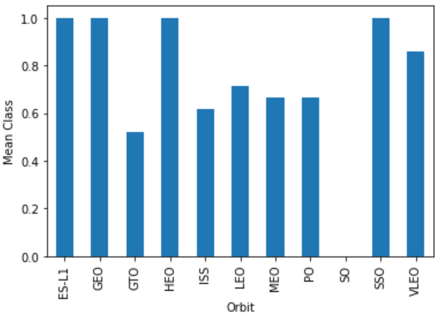
Success Rate vs. Orbit Type
Some Orbit Types have very high success rates, other have very low.
It seems that a successful launch is dependent on the orbit type.

Slide 21
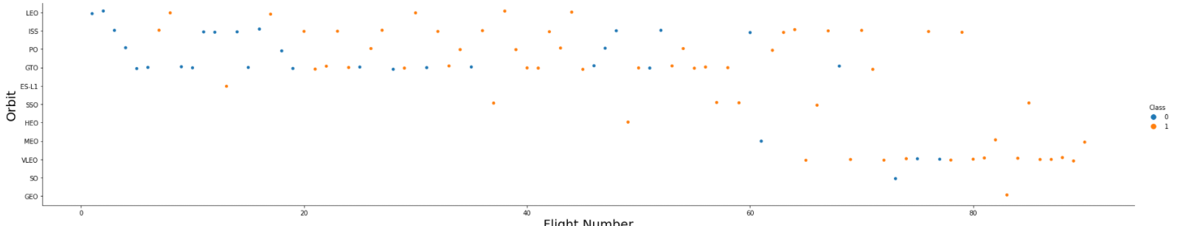
Flight Number vs. Orbit Type
Flight number vs. Orbit type
LEO orbit the Success appears related to the number of flights; on the other hand, there seems to be no relationship between flight number when in GTO orbit

Slide 22
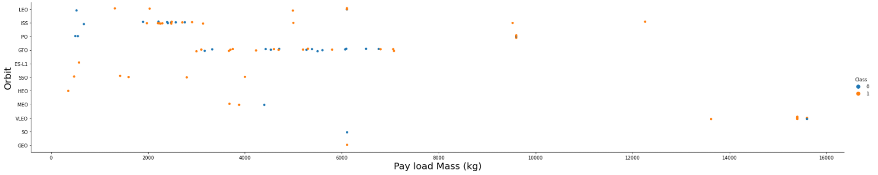
Payload vs. Orbit Type
payload vs. orbit type
Heavy payloads have a negative influence on GTO orbits and positive on GTO and Polar LEO (ISS) orbits

Slide 23
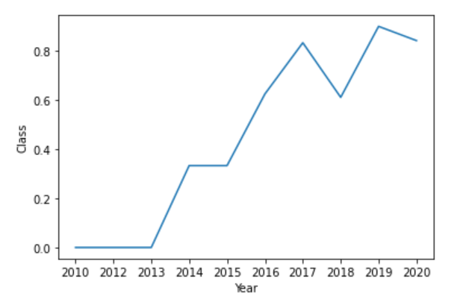
Launch Success Yearly Trend
Success rate since 2013 kept increasing till 2020

Slide 24
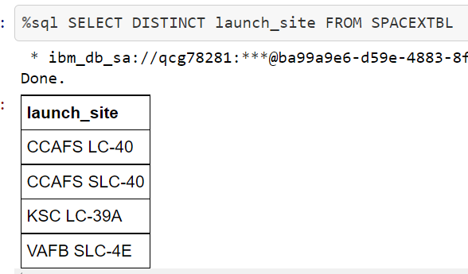
All Launch Site Names
Find the names of the unique launch sites
Present your query result with a short explanation here

Slide 25
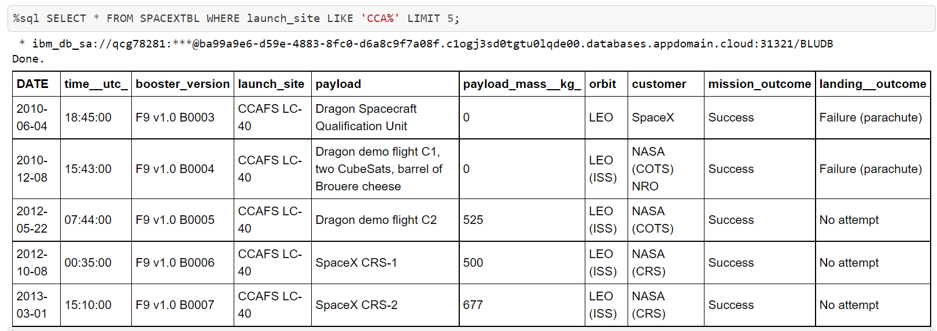
Launch Site Names Begin with 'CCA'
Find 5 records where launch sites begin with `CCA`

Slide 26
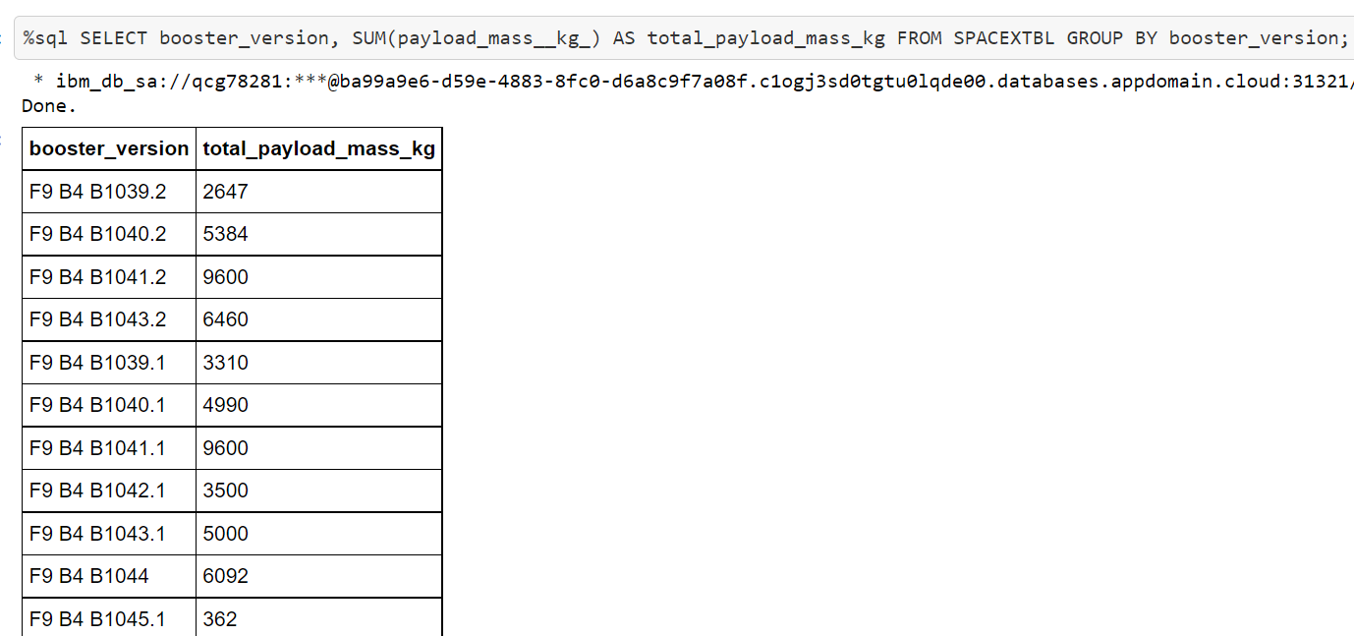
Total Payload Mass
Calculate the total payload carried by boosters from NASA

Slide 27
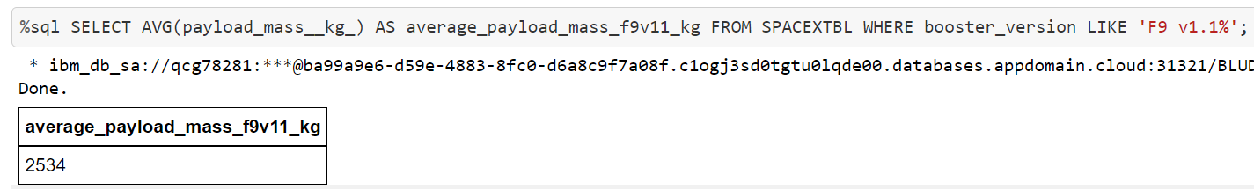
Average Payload Mass by F9 v1.1
Calculate the average payload mass carried by booster version F9 v1.

Slide 28
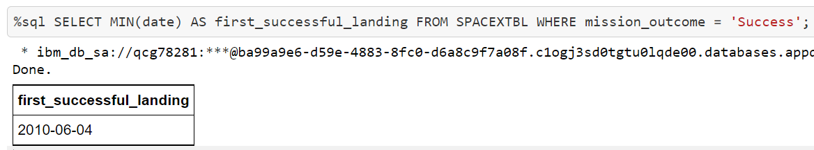
First Successful Ground Landing Date
Find the dates of the first successful landing outcome on ground pad

Slide 29
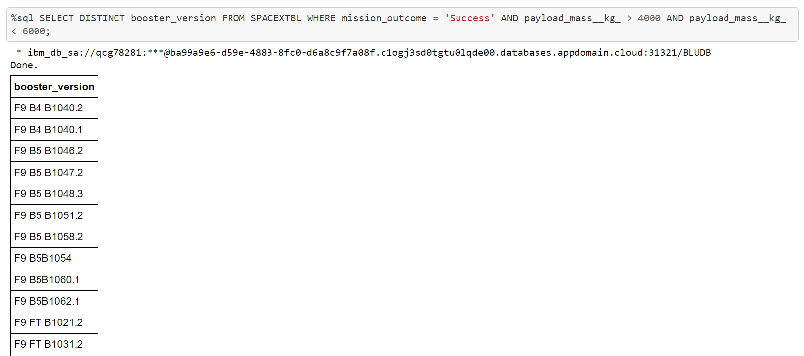
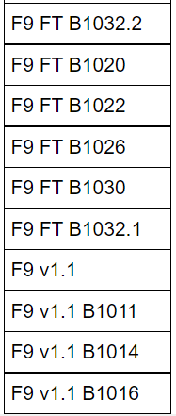
Successful Drone Ship Landing with Payload between 4000 and 6000
List the names of boosters which have successfully landed on drone ship and had payload mass greater than 4000 but less than 6000

Slide 30
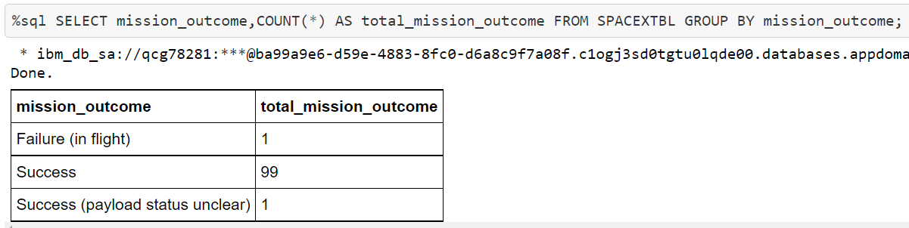
Total Number of Successful and Failure Mission Outcomes
Calculate the total number of successful and failure mission outcomes
Present your query result with a short explanation here

Slide 31
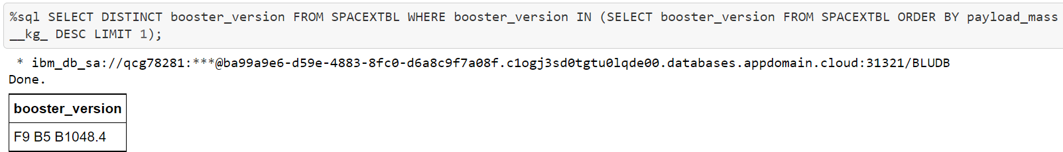
Boosters Carried Maximum Payload
List the names of the booster which have carried the maximum payload mass
Present your query result with a short explanation here

Slide 32
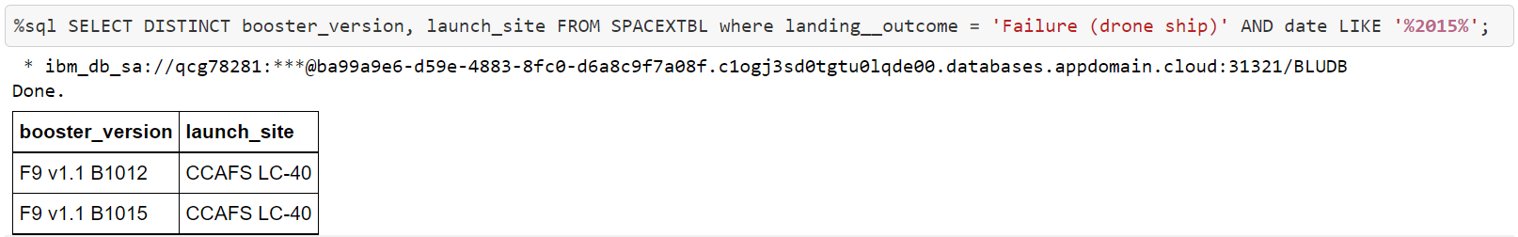
2015 Launch Records
List the failed landing_outcomes in drone ship, their booster versions, and launch site names for in year 2015
Present your query result with a short explanation here

Slide 33
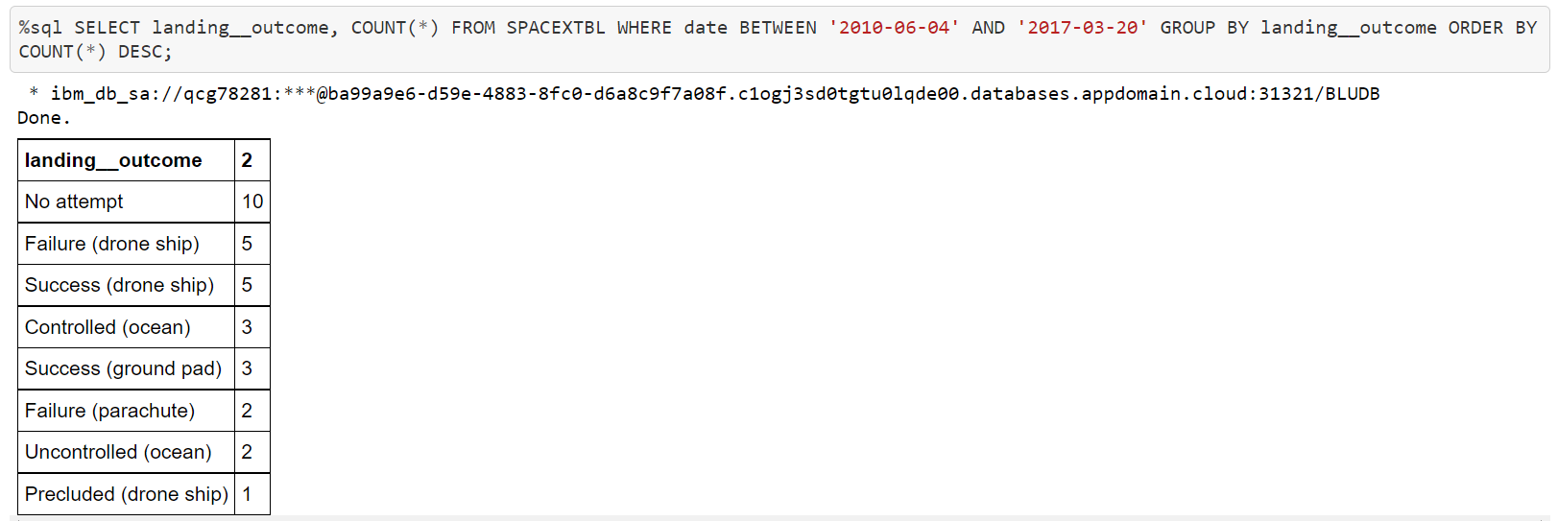
Rank Landing Outcomes Between 2010-06-04 and 2017-03-20
Rank the count of landing outcomes (such as Failure (drone ship) or Success (ground pad)) between the date 2010-06-04 and 2017-03-20, in descending order
Present your query result with a short explanation here

Slide 34


Slide 35
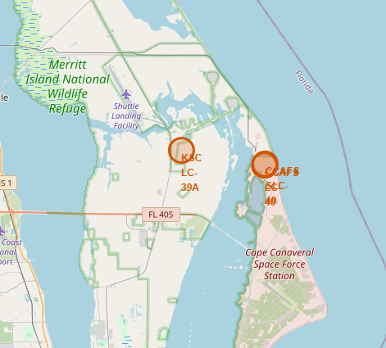
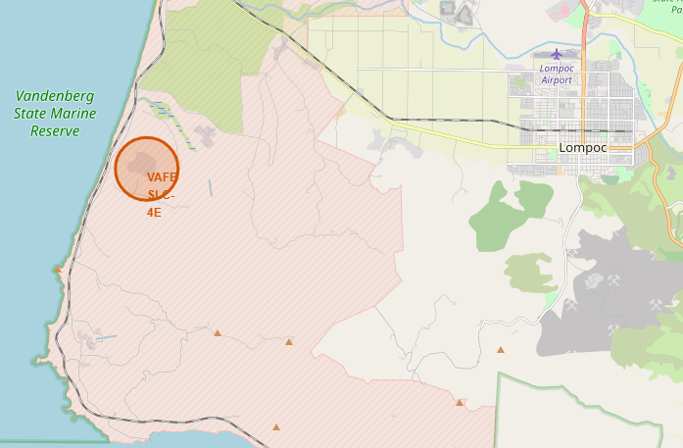
Launch sites locations
Launch sites in proximity to the Equator line
Launch sites in very close proximity to the coast

Slide 36
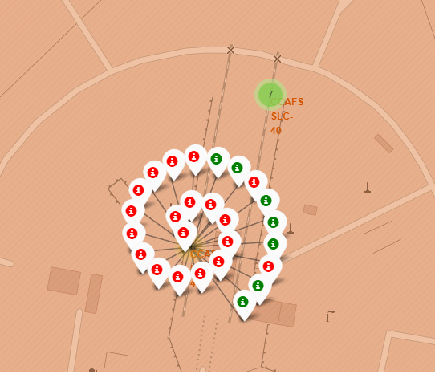
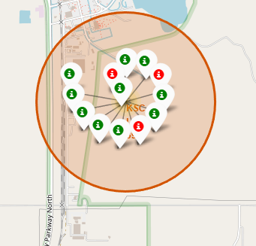
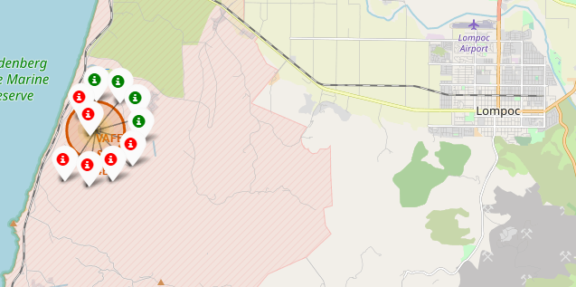
Success/failed launches for each site
Bad rates sites
Good rates sites

Slide 37
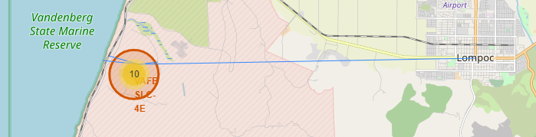
Launch Sites and Proximities
All sites are close to the coast and far from cities. Some of them are close to the highway and railway

Slide 38


Slide 39
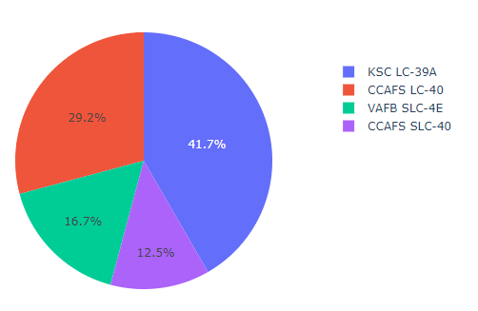
Success count for all sites
The majority of the successful launches have been done on the site KSC LC-39A

Slide 40
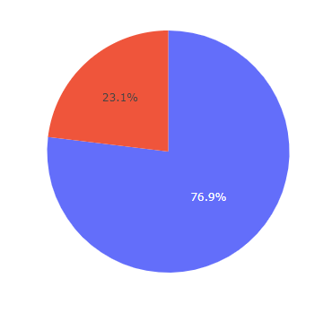
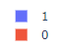
Highest launch success
For the site KSC LC-39A it is possible to see that the success rate is very high: 76.9%

Slide 41
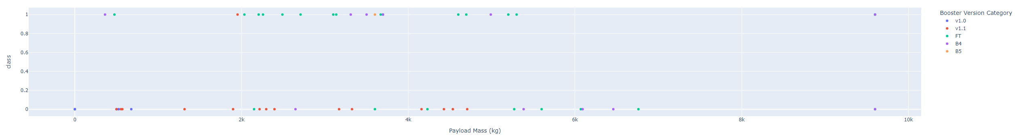
Payload vs. Launch Outcome
We can clearly see from the plot that the booster version FT has higher success rate when the payload is between 2k and 6k.
The booster v1.1 instead has a bad success rate

Slide 42


Slide 43
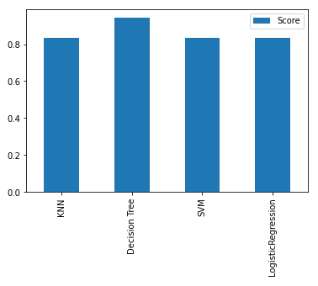
Classification Accuracy
The highest accuracy is given by the decision tree model.
The other models perform more or less the same

Slide 44
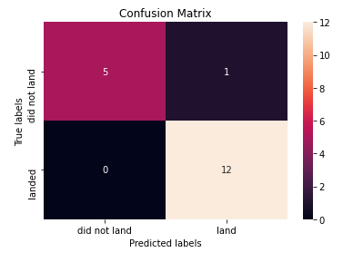
Confusion Matrix
5 records on the test set which did not land were identified correctly by the model
1 record which did not land was identified incorrectly as landed by the model
12 landed cases were all identified correctly

Slide 45
Conclusions
Decision tree model performed the best
We can use this model to predict with a high confidence if the launch will land successfully
0.94% of success of the model on the test set is high rate which shows that we did not overfit the training set.
We are ready to open our SpaceY company ☺

Slide 46
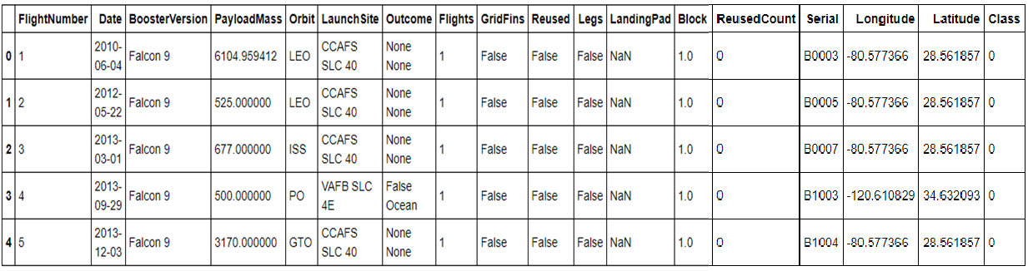
Appendix
Original data set preview

Slide 47


